Slide 1
Legal process outsourcing- the perfect investment opportunity to earn
Presented by: Dr. Velma Brown-Hamilton
Attorney-at-Law
Managing Partner- Caribbean Legal Suite
President- Centennial Legis Solutions

Slide 2

LEGAL PROCESS OUTSOURCING DEFINED
Legal process outsourcing is the process of assigning law-related tasks to an external firm (globally) that is able to handle those tasks efficiently. A lot of small and large-scale law firms are outsourcing legal work to external firms nowadays. India is at present world’s leading LPO destination
.

Slide 3
SERVICES lPo’S offer to law firms:
Legal Accounting
Contract drafting review and management
Document review and drafting
Discovery
Legal Research and Writing
Litigation Support
Data Analysis and Management

Slide 4
tOP TRENDS IN LEGAL OUTSOURCING
Outsourcing continues to grow – and its stigma is diminishing
Lean and mean legal functions are a top priority
Hybrid onshore/ offshore outsourcing is very popular

Slide 5
A career launching experience
New lawyers are able to achieve important career launching experience by doing work for an LPO. Several brilliant and skilled individuals opt to work in this area.

Slide 6
LPO opens new doors:
Support to law firms
Support to legal departments of corporations
Support to organizations in their quest for profitability through cost reduction, efficiency, quick turn around times, while maintaining quality

Slide 7
The market data speaks
The Market
Large and growing
Driven by high demand
Forrester predicted that (i) e-discovery technology spending
(ii) Legal jobs outsourced to India alone, would climb from 12,000 in 2004 to 39,000 in 2008 and 79,000 by 2015.

Slide 8
DATA SPEAKS
KPMG- First level document
Review costs is estimated to be between 58% and 90% of total litigation costs.
PWC – Top priorities for law firms in 2016:
        - To improve the use of technology
        Standardize business processes
        Grand View Research: Estimated a USD $2.35 billion value of the LPO market in 2015 and set to climb to USD 27.19 billion by 2024

Slide 9
GLOBAL STRATEGY FOR MULTINATIONALS
Cost restructuring
Quality improvement
Focus on core business and innovation
Speed to market
Increased revenue
Law society of England and Wales
“ Globalization of business activities remains a key feature for top 200 city and large corporate firms”

Slide 10

FACTORS INFLUENCING THE LPO TREND:
Globalization

Slide 11

mARKET DRIVEN
Economic variations along with increasing price of legal sources

Slide 12

Market driven
Development of this internet technology

Slide 13

Market driven
Increased automation of legal functions

Slide 14

MARKET DRIVEN
Improvements in Information Security

Slide 15

mARKET DRIVEN
New technological tools

Slide 16
LPO structure drives profitability of the client
Accessibility to outside talent
Round the clock availability
The ability to cut back other operations

Slide 17
Is LPO OPPORTUNITY PERFECT?
Obstacles there are:
Lack of awareness
Information security concerns
Research and document review dominates effectuve work
Outsourcing requires updating: technology, mindset, culture etc.

Slide 18
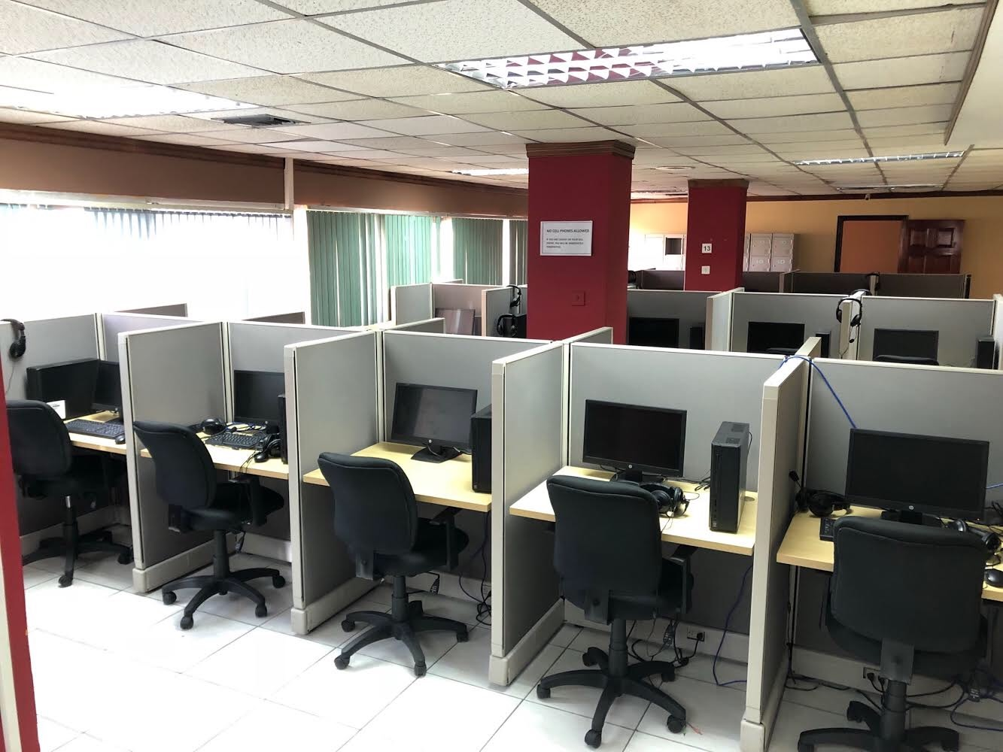
THE OPPORTUNITY IS REAL
The investment is worth it
Meet Centennial Legis Solutions LPO service provider at 2-6 Grenada Crescent, New Kingston, Jamaica

Slide 19
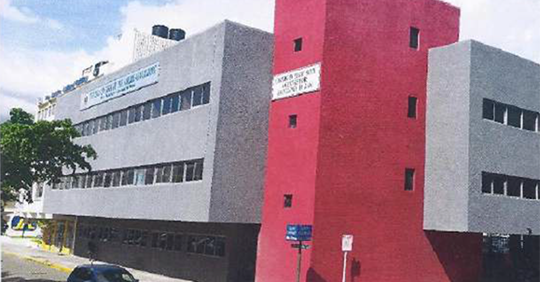

Slide 20
Cls offerings:
Legal document review and finalization
Legal drafting/ document preparation
Legal research
Contract management
Handling of compliance related issues
Success Factor
Have managed to get local and international alliance generating local and foreign currency

Slide 21
WELCOME TO THE LUCRATIVE WORLD OF LEGAL PROCESS OUTSOURCING FOR ALL STAKEHOLDERS. IT IS AS CLOSE TO PERFECTION AS AN INVESTMENT AS ONE COULD GET.

Slide 22

THANK YOU

